Slide 1
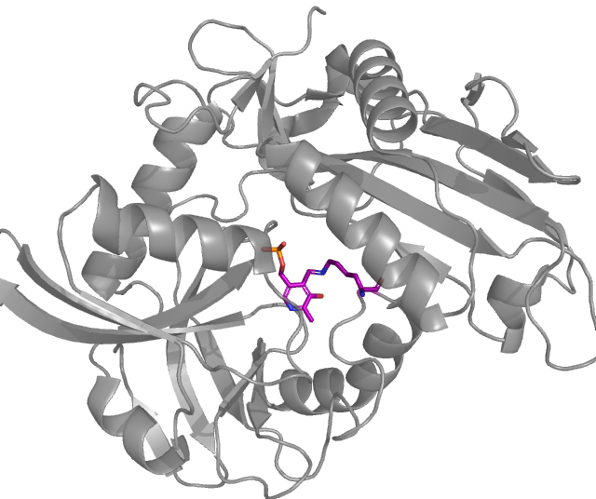
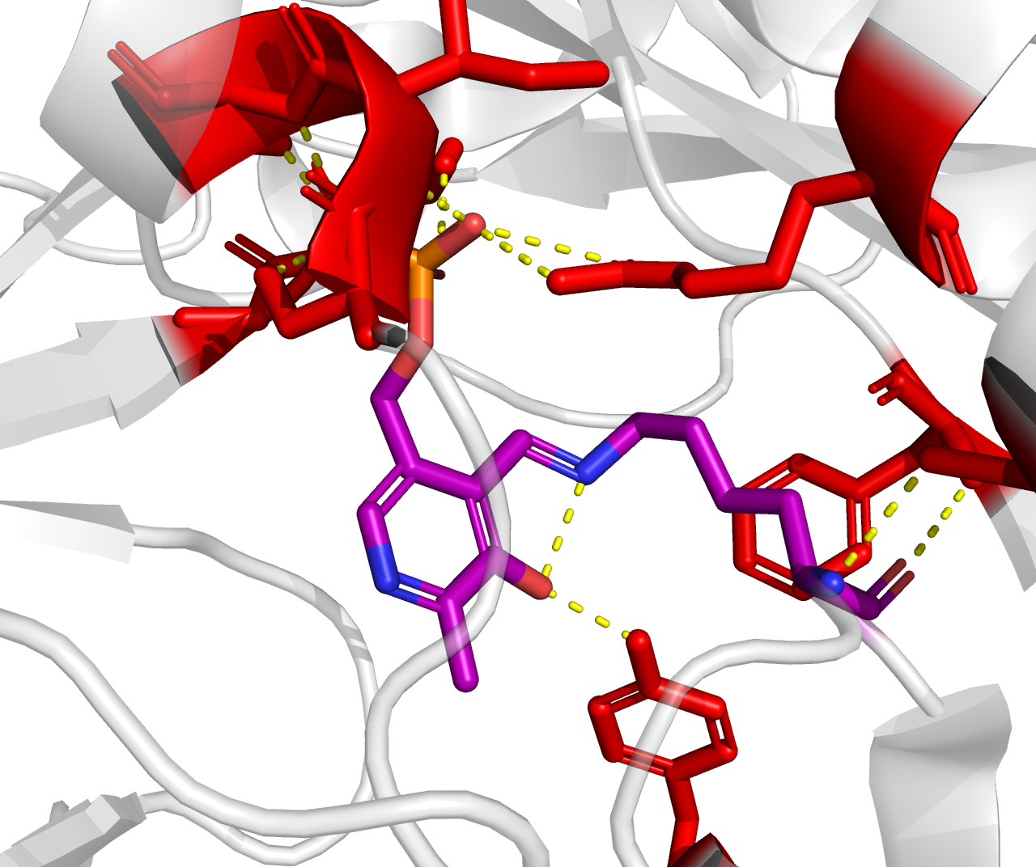
A.
B.
T261
I260
R84
G297
S259
F60
S88
Y192
PLP Ligand binded to
K187 to form
LLP

